Slide 1
Chap 3. Finding Similar Items
3.4 Locality-Sensitive Hashing for Documents
3.5 Distance Measures
Gabriella Pasya Irianti
226750

Slide 2
Why we need to extend Minhashing?
Candidate
pairs:
those pairs
of signatures
that we need
to test for
similarity
Locality-
Sensitive
Hashing
Shingling
Min Hashing
Docu-
ment
The set
of strings
of length k
that appear
in the doc-
ument
Signatures:
short integer
vectors that
represent the
sets, and
reflect their
similarity
J. Leskovec, A. Rajaraman, J. Ullman: Mining of Massive Datasets, http://www.mmds.org
2

Slide 3
3.4.1 LSH for Minhash Signatures
For Min-Hash matrices:
Hash columns of signature matrix M to many buckets
Each pair of documents that hashes into the same bucket is a candidate pair
Pick a similarity threshold s (0 < s < 1)
Columns x and y of M are a candidate pair if their signatures agree on at least fraction s of their rows: M (i, x) = M (i, y) for at least frac. s values of I. We expect documents x and y to have the same (Jaccard) similarity as their signatures
Arrange that (only) similar columns are likely to hash to the same bucket, with high probability
Candidate pairs are those that hash to the same bucket
Partition M into b bands
r rows
per band
b bands
One
signature
Signature matrix M

Slide 4
3.4.2 Analyses of the Banding Techniques
We can calculate the probability that these documents (or rather their signatures) become a candidate pair as follows:
The probability that the signatures agree in all rows of one particular band is s^{r}
The probability that the signatures disagree in at least one row of a particular band is 1 − s^{r}
The probability that the signatures disagree in at least one row of each of the bands is (1 − s^{r})^{b}
The probability that the signatures agree in all the rows of at least one band, and therefore become a candidate pair, is 1 − (1 − s^{r})^{b}
At least
one band
identical
No bands
identical
Probability
of sharing
a bucket
1 -
(
)^{b}
s ~ (1/b)^{1/r}
1 -
t ^{r}
All rows
of a band
are equal
Some row
of a band
unequal
Similarity t=sim(C₁, C₂) of two sets
4

Slide 5
3.4.3 Combining the Techniques
Document
Pick a value of k and construct from each document the set of k-shingles. Optionally, hash the k-shingles to shorter bucket numbers.
Sort the document-shingle pairs to order them by shingle.
Pick a length n for the minhash signatures. Feed the sorted list to compute the minhash signatures for all the documents.
Choose a threshold t that defines how similar documents have to be in order for them to be regarded as a desired “similar pair.”
Shingling
Min
hashing
Locality-
Sensitive
Hashing

Slide 6
3.4.3 Combining the Techniques
Buckets
Columns 2 and 6
are probably identical
(candidate pair)
Divide matrix M into b bands of r rows
For each band, hash its portion of each column to a hash table with k buckets
Make k as large as possible
Candidate column pairs are those that hash to the same bucket for ≥ 1 band
Tune b and r to catch most similar pairs, but few non-similar pairs
Columns 6 and 7 are
surely different.
Matrix M
r rows
b bands

Slide 7
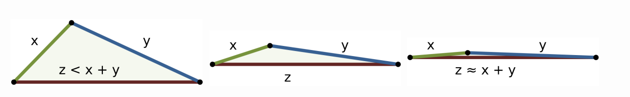
3.5 Distance Measures
3.5.1 Definition of A Distance Measures
A distance measure on this space is a function d(x, y) that takes two points in the space as arguments and produces a real number, and satisfies the following axioms:
d(x, y) ≥ 0 (no negative distances).
d(x, y) = 0 if and only if x = y (distances are positive, except for the distance from a point to itself).
d(x, y) = d(y, x) (distance is symmetric).
d(x, y) ≤ d(x, z) + d(z, y) (the triangle inequality).

Slide 8
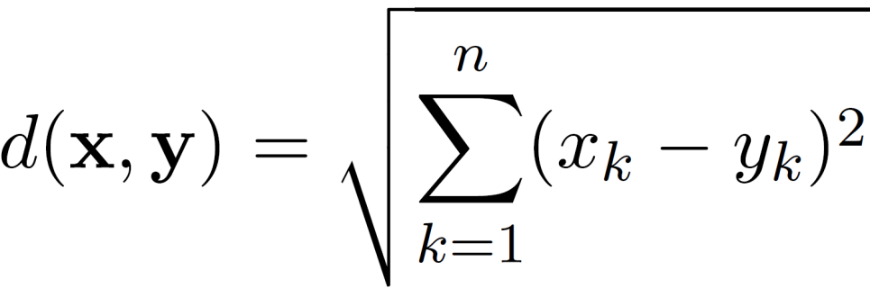
3.5.2 Eucledian Distance
The Euclidean distance, d , between two points, x and y , in one-, two-, three-, or higher-dimensional space, is given by
where n is the number of dimensions (attributes) and x_{k} and y_{k} are, respectively, the k^{th} attributes (components) of data objects x and y.
Standardization is necessary, if scales differ.

Slide 9
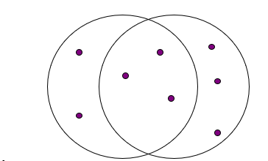

3.5.3 Jaccard Distance
Jaccard Similarity
Jaccard distance:
$$JDist(X,Y) = 1 – JSim(X,Y)$$
The Jaccard similarity (Jaccard coefficient) of two sets S₁, S₂ is the size of their intersection divided by the size of their union.
JSim (S₁, S₂) = |S₁∩S₂| / |S₁∪S₂|.
Extreme behavior:
Jsim(X,Y) = 1, iff X = Y
Jsim(X,Y) = 0 iff X,Y have no elements in common
JSim is symmetric
JDist(x,x) = 0 since JSim(x,x) = 1
JDist(x,y) = JDist(y,x) by symmetry of intersection
JDist(x,y) > 0 since intersection of X,Y cannot be bigger than the union.
Triangle inequality:
Follows from the fact that JSim(X,Y) is the probability of randomly selected element from the union of X and Y to belong to the intersection
3 in intersection.
8 in union.
Jaccard similarity = 3/8

Slide 10
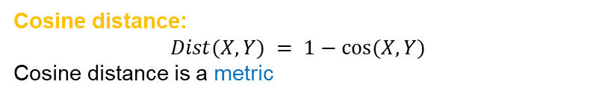
3.5.4 Cosine Distance
Cosine Similarity
Sim(X,Y) = cos(X,Y)
The cosine of the angle between X and Y
If the vectors are aligned (correlated) angle is zero degrees and cos(X,Y)=1
If the vectors are orthogonal (no common coordinates) angle is 90 degrees and cos(X,Y) = 0
Cosine is commonly used for comparing documents, where we assume that the vectors are normalized by the document length, or words are weighted by tf-idf.
Cosine distance:
$$Dist(X,Y) = 1−cos⁡(X,Y)$$
Cosine distance is a metric

Slide 11
3.5.5 Edit Distance
Distance between strings
Why Edit distance is a Matrix?
How do we define similarity between strings?
weird wierd
intelligent unintelligent
Athena Athina
The edit distance of two strings is the number of inserts and deletes of characters needed to turn one into the other.
Example: x = abcde ; y = bcduve.
Turn x into y by deleting a, then inserting u and v after d.
Edit distance = 3.
Minimum number of operations can be computed using dynamic programming
Common distance measure for comparing DNA sequences
d(x,x) = 0 because 0 edits suffice.
d(x,y) = d(y,x) because insert/delete are inverses of each other.
d(x,y) > 0: no notion of negative edits.
Triangle inequality: changing x to z and then to y is one way to change x to y. The minimum is no more than that
Variant Edit Distances
Allow insert, delete, and mutate.
Change one character into another.
Minimum number of inserts, deletes, and mutates also forms a distance measure.

Slide 12
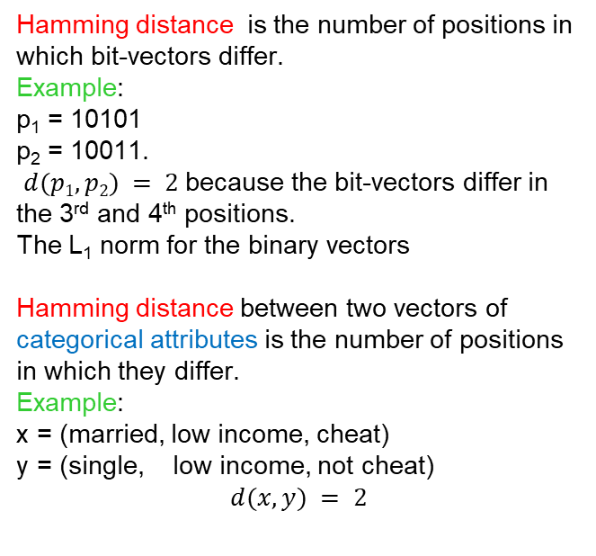
3.5.5 Hamming Distance
Hamming distance is the number of positions in which bit-vectors differ.
Example:
p₁ = 10101
p₂ = 10011.
$d(p1, p2) = 2$because the bit-vectors differ in the 3rd and 4th positions.
The L₁ norm for the binary vectors
Hamming distance between two vectors of categorical attributes is the number of positions in which they differ.
Example:
x = (married, low income, cheat)
y = (single, low income, not cheat)
$$d(x,y) = 2$$
Why Hamming distance is a Matrix?
d(x,x) = 0 since no positions differ.
d(x,y) = d(y,x) by symmetry of “different from.”
d(x,y) > 0 since strings cannot differ in a negative number of positions.
Triangle inequality: changing x to z and then to y is one way to change x to y.
For binary vectors if follows from the fact that L₁ norm is a metric

Slide 13
Thanks!

